Slide 1

Introduction to RNA-seq
bioDSC workshop
2 & 4 March 2026

Slide 2
Workshop schedule
DAY 1 (13:00-17:00, 4 hrs)
-. Welcome day 1 + mini lecture (30 min)
1. Read quality control (30 min)
2. Read trimming (30 min)
3. Inspecting .bam and .sam files (30 min)
4. Counting reads (30 min)
6. Practice more! (30 min)
Total: 3 hours (room for breaks, practicing or delays ☺)
DAY 2 (13:00-17:00, 4 hrs)
Welcome day 2
1. Downloading the data and setting up R (15 min)
7. Differential gene expression analysis (60 min)
8. Enrichment analysis (30 min)
9. Practice by yourself with a new data set (x min)

Slide 3
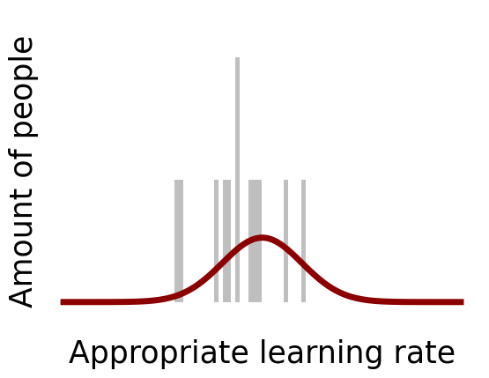

Workshop style: “Carpentries”
Carpentries:
https://carpentries.org/
Evidence based teaching practices
Live coding, type along
“What’s happening?!”
“Please go faster”
🤯
🙄

Slide 4
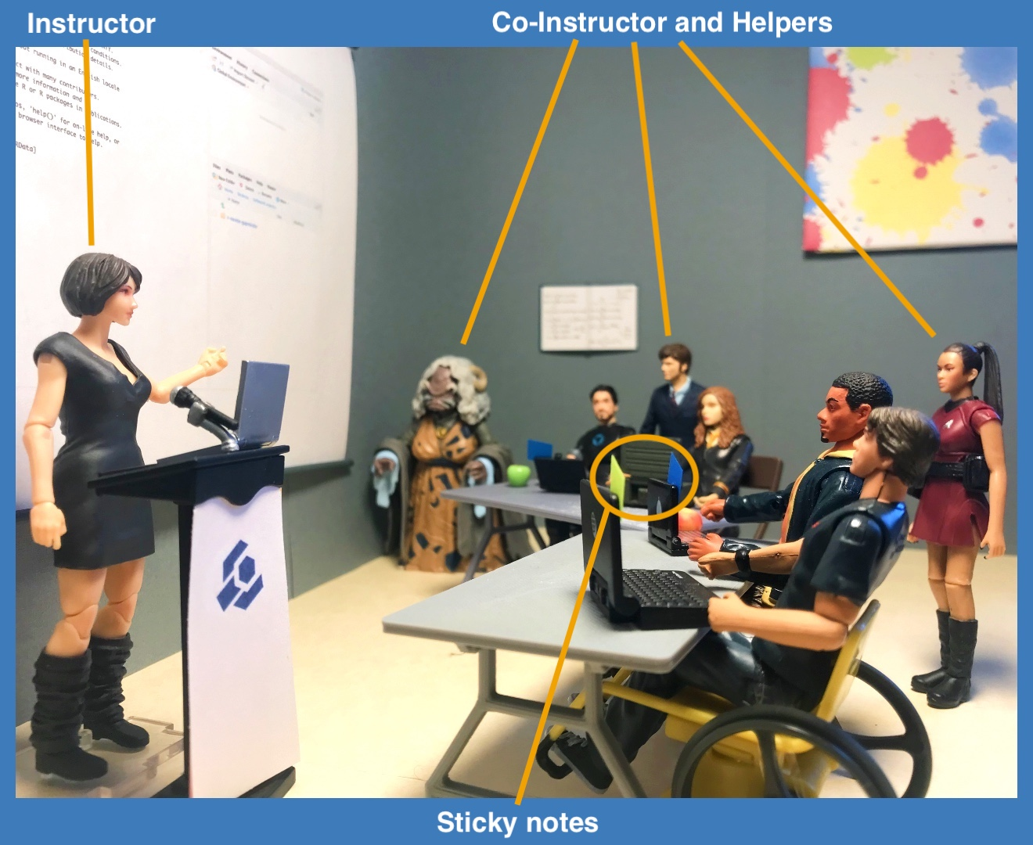
Workshop style: “Carpentries”
Carpentries Code of conduct
Growth mindset
Be respectful
Here to learn
Mistakes are to learn from
Stickies
Blue = done
Yellow = help needed

Slide 5
Refresher 1: hypothesis testing
In an RNA-seq experiment, you will measure the expression of 1000s of genes
Essentially, we try to answer the question ”Is Gene x differentially expressed and higher in treatment y than treatment z?” many times

Slide 6
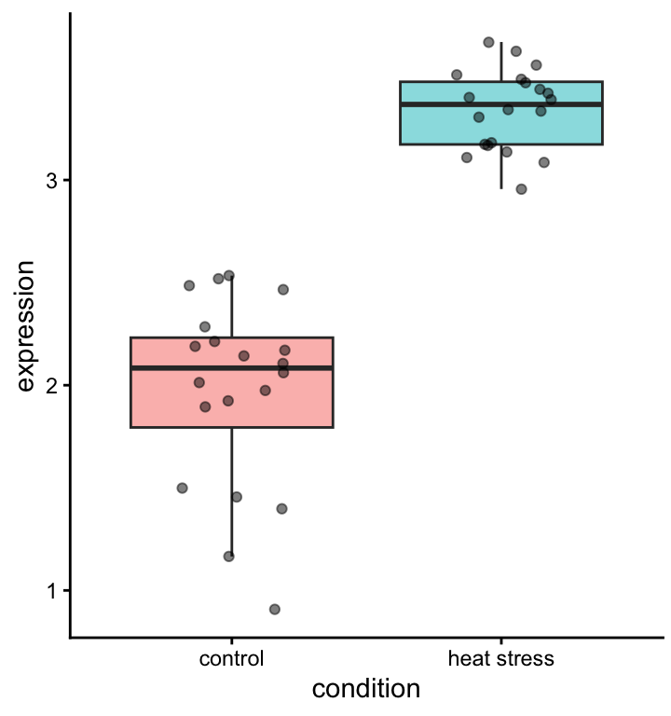
Median: measure of central tendency
Alternative: ?
Quantiles: measure of spread
Alternative: ?

Slide 7
Is this difference significant?
t-test
The power of a statistical test depends on:
The spread in the data
The effect size
The number of replicates

Slide 8
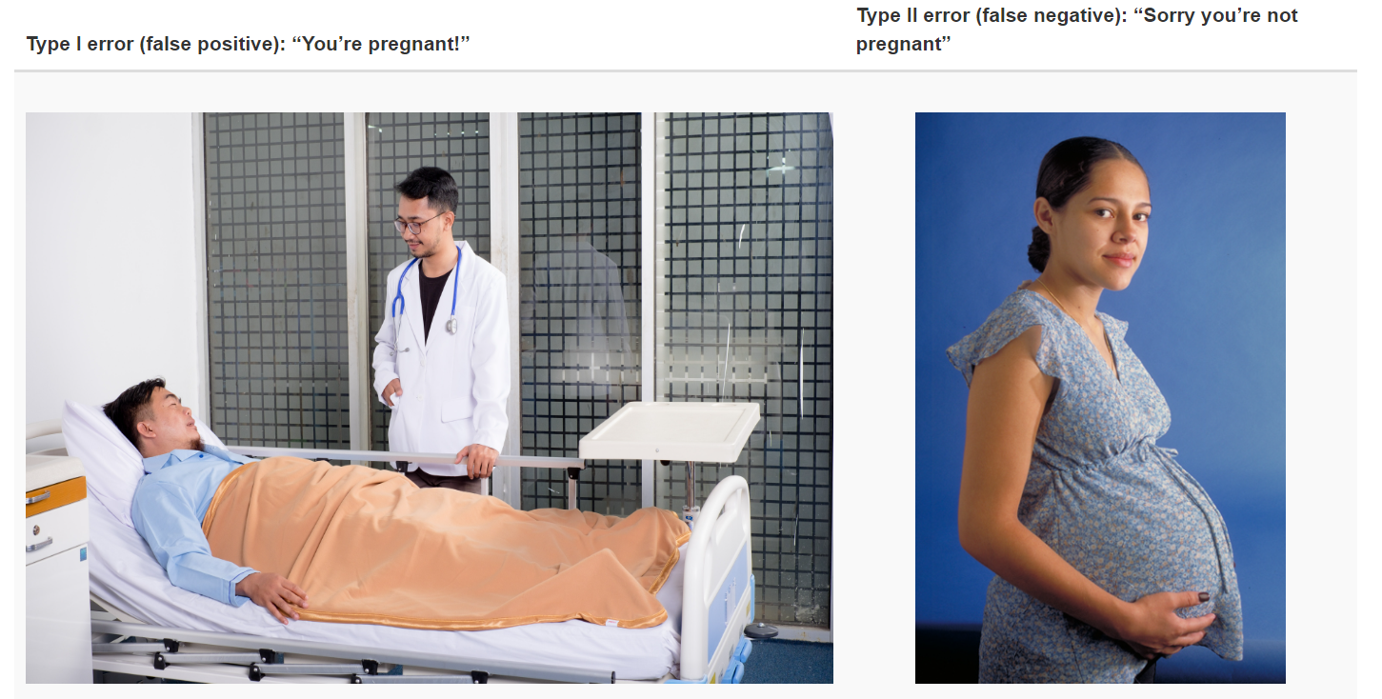
Type I and type II errors

Slide 9
Power analysis for RNA-seq
https://rnaseq-power.serve.scilifelab.se/app/rnaseq-power

Slide 10
Refresher 2: Experimental design
In an RNA-seq experiment, you will measure the expression of 1000s of genes.
Therefore, we need to keep all sources of unwanted variation to a minimum.

Slide 11
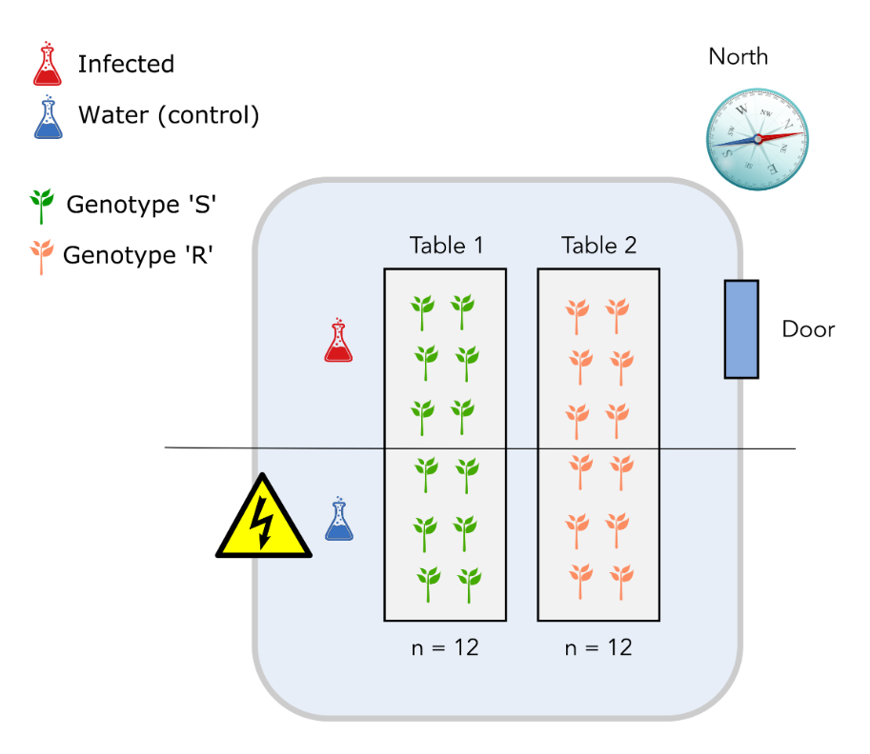
Design 1
Table effect the same as genotype effect!

Slide 12
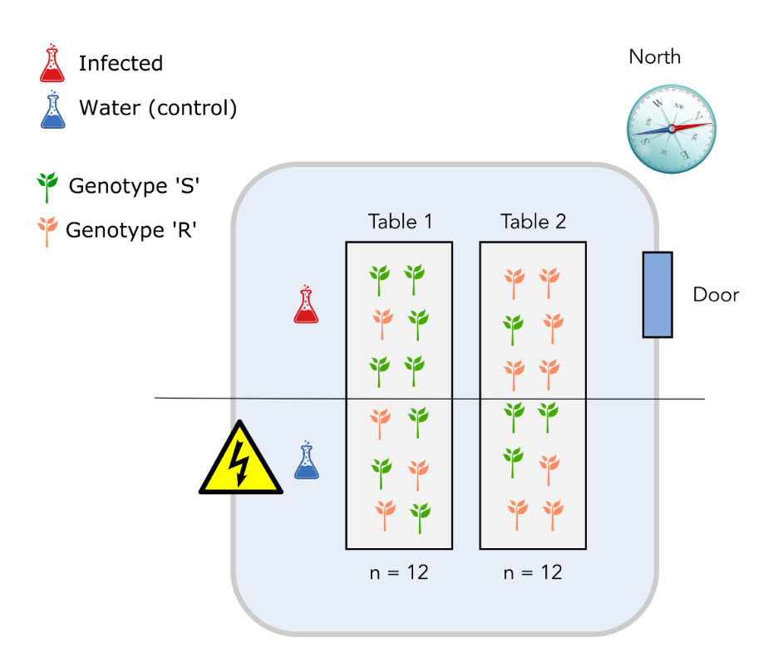
Design 2
'North-south’ effect the same as infection effect!

Slide 13
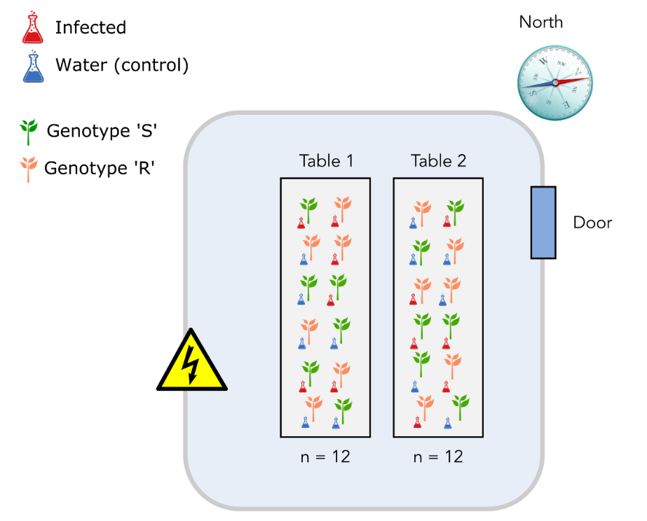
Design 3
Properly randomized design ☺

Slide 14
From sample to reads
Take from Tijs slides:
RNA-isolation
Library prep (super quick)
Sequencing animation
Quality + fastq file layout

Slide 15
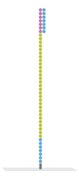

Slide 22
Typically a run consists of 50 to 150 cycles.
> This determines read length

Slide 23
Every sequencing cycle for each spot a base is called and a quality value is given.
(for Illumina, from 0 to 40)

Slide 25
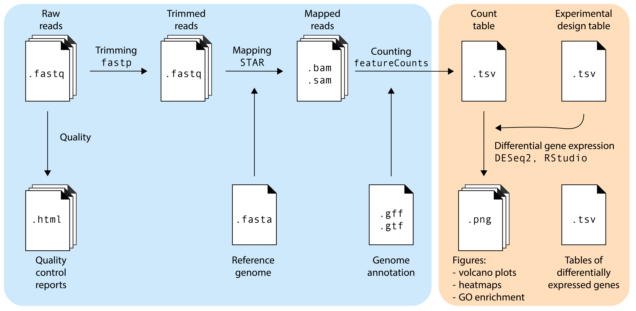
Day 1
Day 2

Slide 26
Workshop logistics
Link to Google colab
Link to hackMD?
Link to materials

